Slide 1


Books Recommendation system with chatbot
Group 8

Slide 2



Books Recommendation system with chatbot
1. Recommend Random book
2. Review
3. Classify the review
4. Get the Recommendation

Slide 3
Tabel of content
Data Preprocessing
Feature Engineering
Classification Based on Books Reviews
Classification Error Analysis
Clustering Based on Books Description
Clustering Error Analysis
Build The Recommenders
Develop The Chatbot
Connect The Chatbot with The Recommender
Error Analysis on the Entire System

Slide 4
Data preprocessing
Load dataset ‘data of amazon book reviews’
We used google books api to get more details about the book
Remove nan
Undersampling
Drop extra columns

Slide 5
2. Feature engineering
Using LDA
Using TF-IDF

Slide 6
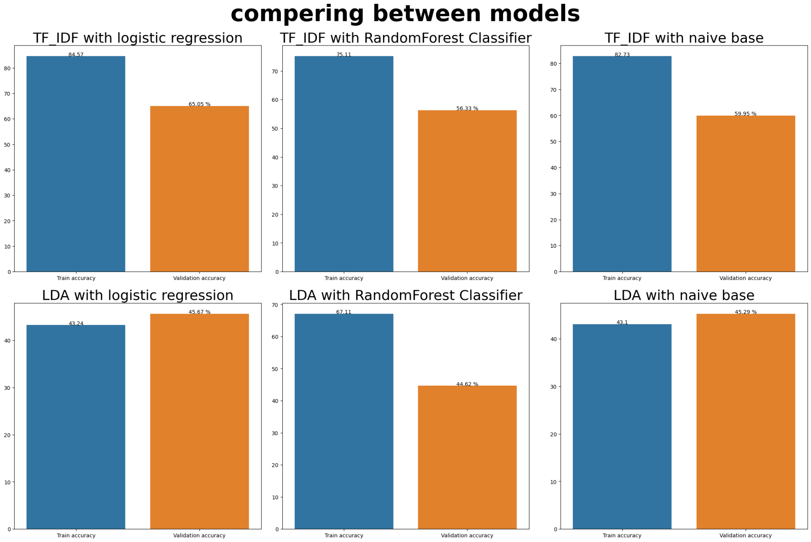
3. Classification based on Books reviews

Slide 7
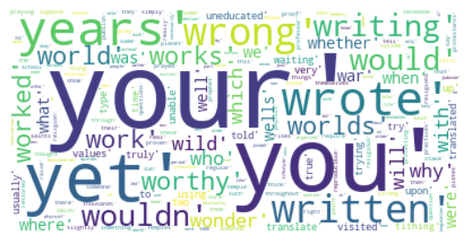
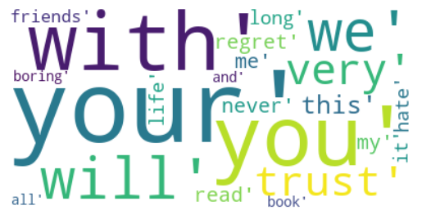
4. Classification Error Analysis

Slide 8
5. Clustering based on Books description
We performed clustering based on the book description to get the similar books
We used k-means and em models for clustering

Slide 9
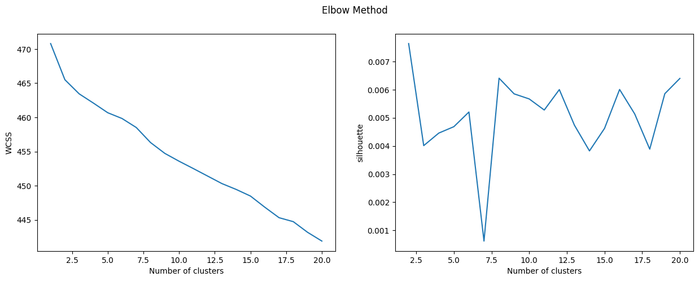
5. Clustering based on Books description (K-means)

Slide 10
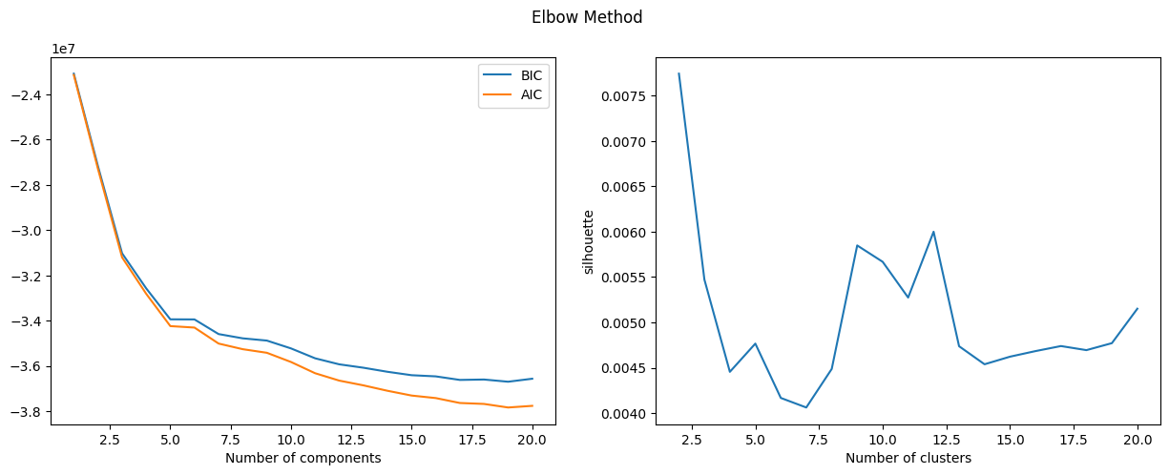
5. Clustering based on Books description (Em)

Slide 11
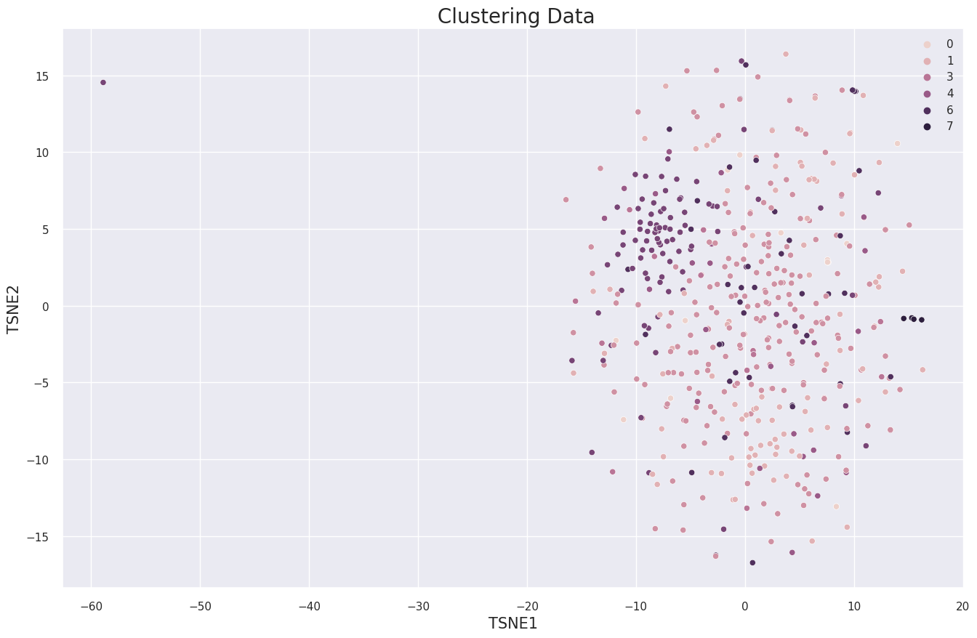
6. Clustering T-SNE

Slide 12
7. Build the Recommenders
1. Popularity Based (Top In whole collection)
2. Recommendation using Average Weighted Rating
3. User-Item Collaborative Filtering Recommendation
4. Recommendation using surprise library (specific to a user )
5. Recommendation using surprise library (not specific to a user )

Slide 13
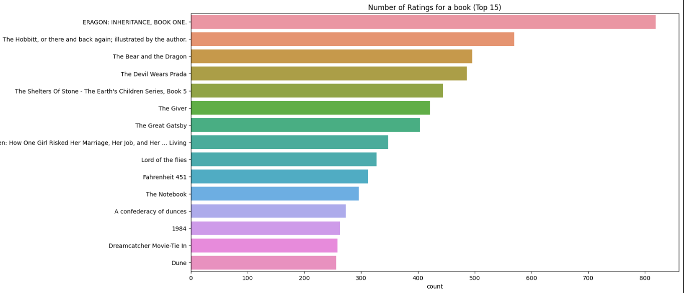
7.1 Popularity Based (Top In whole collection)
Recommend the Top 15 book regarding to the highest count of rates .

Slide 14
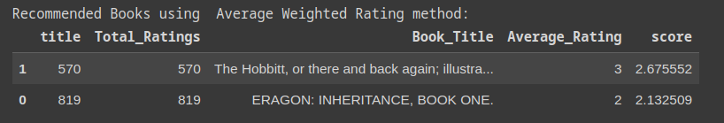
7.2 Recommendation using Average Weighted Rating
We have calculated the weighted score using the below formula for all the books and recommended the books with the highest score.
score= t/(t+m)∗a + m/(m+t)∗c
where : t represents the total number of ratings received by the book
m represents the minimum number of total ratings considered to be included
a represents the average rating of the book and,
c represents the mean rating of all the books.using Average Weighted Rating

Slide 15
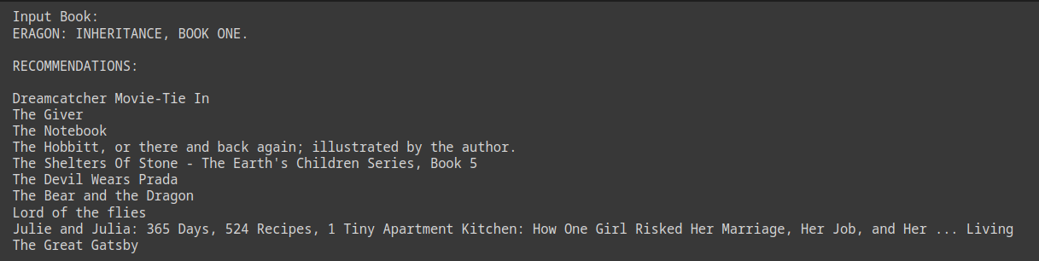
7.3 User-Item Collaborative Filtering Recommendation
Collaborative Filtering Recommendation System works by considering user ratings and finds cosine similarities in ratings by several users to recommend books.

Slide 16


7. Recommendation using surprise library (specific to a user )
User id :
The Recommendation for that user :

Slide 17
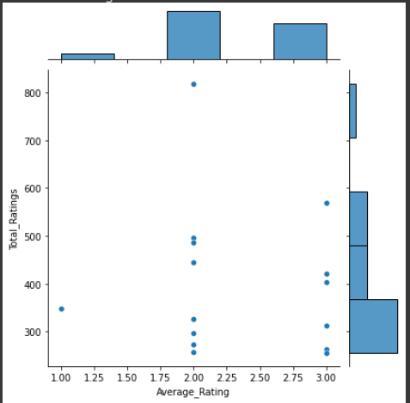
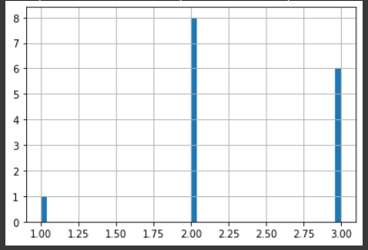
7. Recommendation using surprise library (not specific to a user )
Visualize the average rating

Slide 18


7. Recommendation using surprise library (not specific to a user )

Slide 19

8. Develop the chatbot
9. Connect The Chatbot with The Recommender

Slide 20
References
Lecture notes
https://github.com/ashima96/Book-Recommendation-System
http://snap.stanford.edu/data/web-Amazon-links.html
https://www/googleapis.com/books/v1/volumes?q=[bookname]

Slide 21


